Slide 1

Algorithms and Data Structures 2 CS 1501
Fall 2021
Sherif Khattab
ksm73@pitt.edu
(Slides are adapted from Dr. Ramirez’s and Dr. Farnan’s CS1501 slides.)

Slide 2
Announcements
Upcoming deadlines:
Homework 6 due on 2/28
Lab 6 due on 3/4
Homework 7 due on 3/14
Assignment 1 due on 3/14
Midterm exam on Wednesday 3/2
In-person, paper, closed book exam

Slide 3
Previous lecture …
Can we do better than Huffman’s for lossless compression?
Run-length encoding
Shannon’s entropy
LZW

Slide 4
CourseMIRROR Reflections (most interesting)
I found the discussion about the efficiency runtime interesting
I enjoyed the brief intro to LZW compression as another method
LZW is interesting to see how it builds new codewords
The topic of entropy was most interesting.
How buffers work
The different ways to make the tries in Huffman compression
The rate at which we can compress bits
Information entropy and Kolmogorov complexity

Slide 5
CourseMIRROR Reflections (most confusing)
The specific details with respect to the compression algorithms were most confusing today.
I would like to go over entropy again and how it is calculated
I was a bit confused on how Huffman encoding is the optimal method but we were still trying to find a method that was better
How do we determine how many bits the codebook for LZW should have?
The 12-bit code word and how it is generated.
“Entropy as a measure of surprise”

Slide 6
Problem of the Day: Lossless Compression
Input: A sequence of characters
n characters
each encoded as an 8-bit Extended ASCII
Output: A bit string
of length less than 8*n
the original sequence can be fully restored from the bitstring

Slide 7
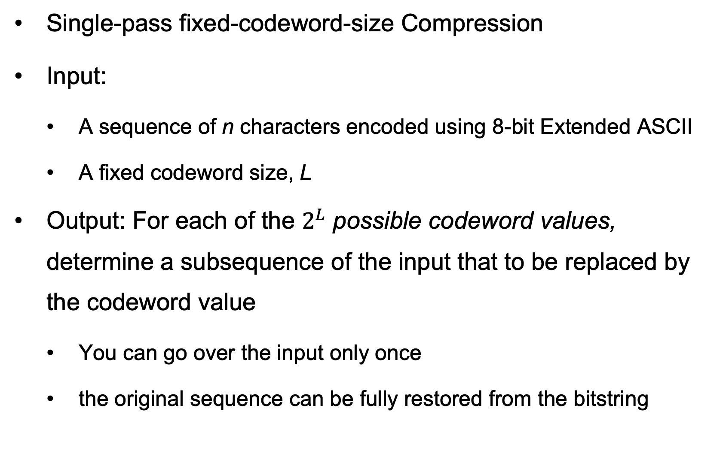
Problem of the Day
Single-pass fixed-codeword-size Compression
Input:
A sequence of n characters encoded using 8-bit Extended ASCII
A fixed codeword size, L
Output: For each of the $2^{L}$ possible codeword values, determine a subsequence of the input that to be replaced by the codeword value
You can go over the input only once
the original sequence can be fully restored from the bitstring

Slide 8
LZW compression
Initialize codebook to all single characters
e.g., character maps to its ASCII value
While !EOF:
Match longest prefix in codebook
Output codeword
Take this longest prefix, add the next character in the file, and add the result to the dictionary with a new codeword

Slide 9
LZW compression example
Compress, using 12 bit codewords:
TOBEORNOTTOBEORTOBEORNOT
Cur
Output
Add
T
84
TT:264
T
84
TO:256
TO
256
TOB:265
O
79
OB:257
BE
258
BEO:266
B
66
BE:258
OR
260
ORT:267
E
69
EO:259
TOB
265
TOBE:268
O
79
OR:260
EO
259
EOR:269
R
82
RN:261
RN
261
RNO:270
N
78
NO:262
OT
263
--
O
79
OT:263

Slide 10
LZW expansion
Initialize codebook to all single characters
e.g., ASCII value maps to its character
While !EOF:
Read next codeword from file
Lookup corresponding pattern in the codebook
Output that pattern
Add the previous pattern + the first character of the current pattern to the codebook
Note this means no codebook addition after first pattern output!

Slide 11
LZW expansion example
Cur
Output
Add
84
T
263:OT
84
T
--
256
TO
264:TT
79
O
256:TO
258
BE
265:TOB
66
B
257:OB
260
OR
266:BEO
69
E
258:BE
265
TOB
267:ORT
79
O
259:EO
259
EO
268:TOBE
82
R
260:OR
261
RN
269:EOR
78
N
261:RN
263
OT
270:RNO
79
O
262:NO

Slide 12
How does this work out?
Both compression and expansion construct the same codebook!
Compression stores character string → codeword
Expansion stores codeword → character string
They contain the same pairs in the same order
Hence, the codebook doesn’t need to be stored with the compressed file, saving space

Slide 13
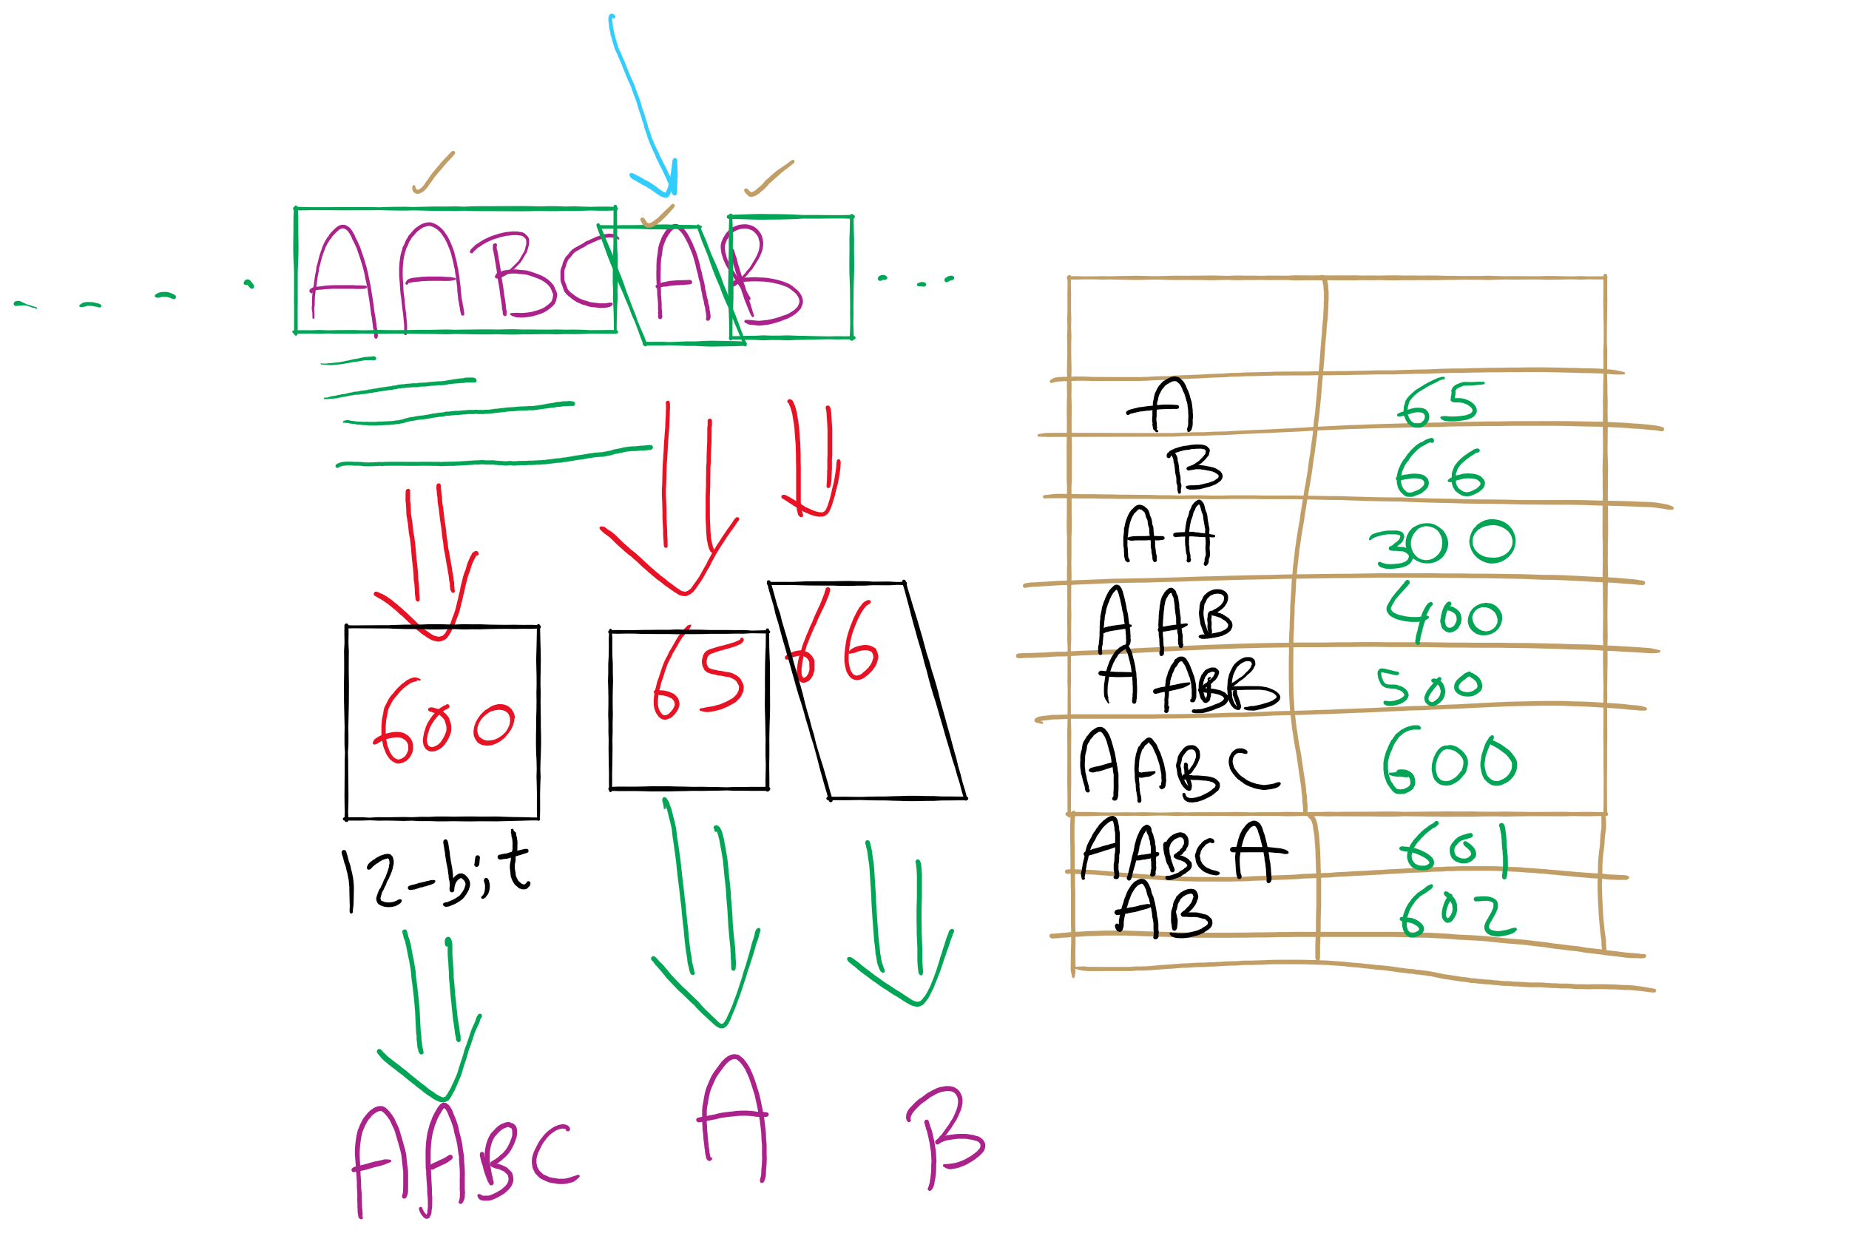
LZW Example

Slide 14
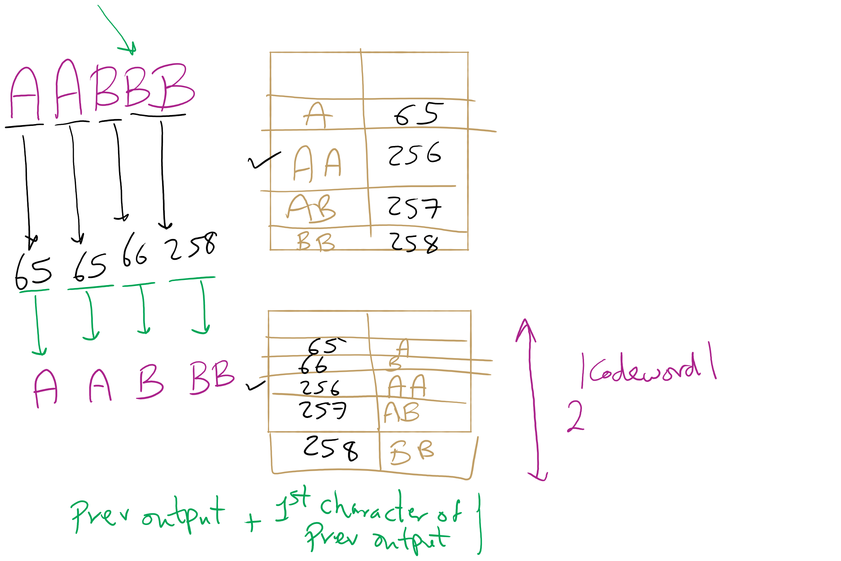
LZW Corner Case

Slide 15
Just one tiny little issue to sort out...
Expansion can sometimes be a step ahead of compression…
If, during compression, the (pattern, codeword) that was just added to the dictionary is immediately used in the next step, the decompression algorithm will not yet know the codeword.
This is easily detected and dealt with, however

Slide 16
LZW corner case example
Compress, using 12 bit codewords: AAAAAA
Cur
Output
Add
A
65
AA:256
AA
256
AAA:257
AAA
257
--
Expansion:
Cur
Output
Add
65
A
--
256
AA
256:AA
257
AAA
257:AAA
Notes:
If a codeword is encountered that is not in the codebook, it must be:
prev_pattern + prev_pattern[0]

Slide 17
LZW implementation concerns: codebook
How to represent/store during:
Compression
Expansion
Considerations:
What operations are needed?
How many of these operations are going to be performed?
Discuss
Notes:
ENCODE: Two most likely candidates:
Trie or Hash Table
Both allow lookups in time proportional to string length, independent of the number of strings
Since the new keys are all prefixes already in the tree, and plus one additional character, and since we are searching for prefixes
The Trie would be a great choice
However, memory issues would make us prefer the DLB
Text LZW.java uses a ternary search trie (TST).
DECODE:
Now codewords are the key values, and the strings are returned
We can simply use the codeword values to index an array of strings
Gives us constant time lookup of the codewords
See LZW.java

Slide 18
Further implementation issues: codeword size
How long should codewords be?
Use fewer bits:
Gives better compression earlier on
But, leaves fewer codewords available, which will hamper compression later on
Use more bits:
Delays actual compression until longer patterns are found due to large codeword size
More codewords available means that greater compression gains can be made later on in the process

Slide 19
Variable width codewords
This sounds eerily like variable length codewords…
Exactly what we set out to avoid!
Here, we’re talking about a different technique
Example:
Start out using 9 bit codewords
When codeword 512 is inserted into the codebook, switch to outputting/grabbing 10 bit codewords
When codeword 1024 is inserted into the codebook, switch to outputting/grabbing 11 bit codewords…
Etc.

Slide 20
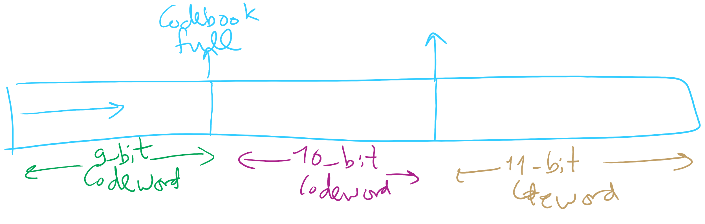
Adaptive Codeword Size

Slide 21
Even further implementation issues: codebook size
What happens when we run out of codewords?
Only 2^{n} possible codewords for n bit codes
Even using variable width codewords, they can’t grow arbitrarily large…
Two primary options:
Stop adding new keywords, use the codebook as it stands
Maintains long already established patterns
But if the file changes, it will not be compressed as effectively
Throw out the codebook and start over from single characters
Allows new patterns to be compressed
Until new patterns are built up, though, compression will be minimal

Slide 22
The showdown you’ve all been waiting for...
HUFFMAN vs LZW
In general, LZW will give better compression
Also better for compression archived directories of files
Why?
Very long patterns can be built up, leading to better compression
Different files don’t “hurt” each other as they did in Huffman
Remember our thoughts on using static tries?

Slide 23
So lossless compression apps use LZW?
Well, gifs can use it
And pdfs
Most dedicated compression applications use other algorithms:
DEFLATE (combination of LZ77 and Huffman)
Used by PKZIP and gzip
Burrows-Wheeler transforms
Used by bzip2
LZMA
Used by 7-zip
brotli
Introduced by Google in Sept. 2015
Based around a " … combination of a modern variant of the LZ77 algorithm, Huffman coding[,] and 2nd order context modeling … "
Notes:
also: lz4, lzham, bitknit as a close competitor to brotli

Slide 24
DEFLATE et al achieve even better general compression?
How much can they compress a file?
Better question:
How much can a file be compressed by any algorithm?
No algorithm can compress every bitstream
Assume we have such an algorithm
We can use to compress its own output!
And we could keep compressing its output until our compressed file is 0 bits!
Clearly this can’t work
Proofs in Proposition S of Section 5.5 of the text

Slide 25
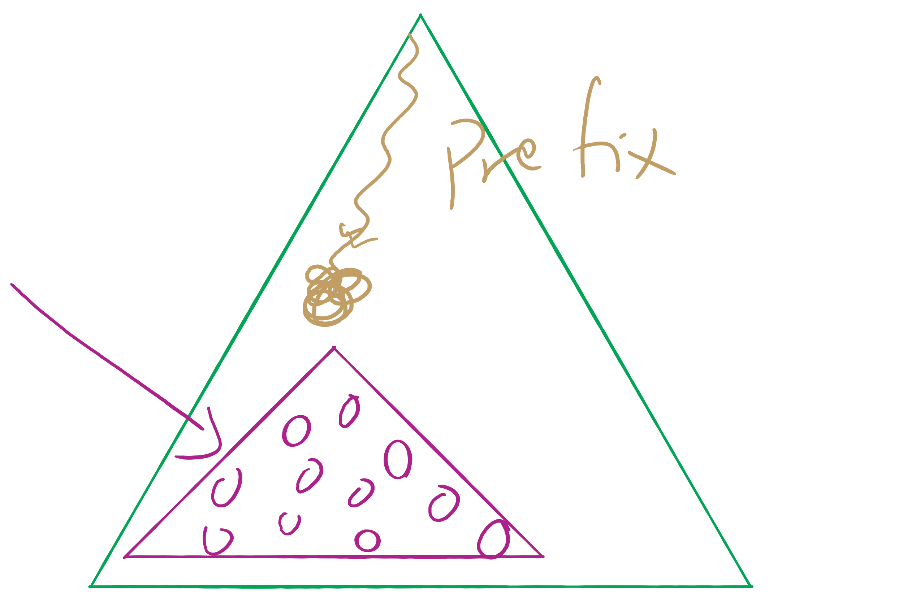
Assignment 2 runtime analysis

Slide 26
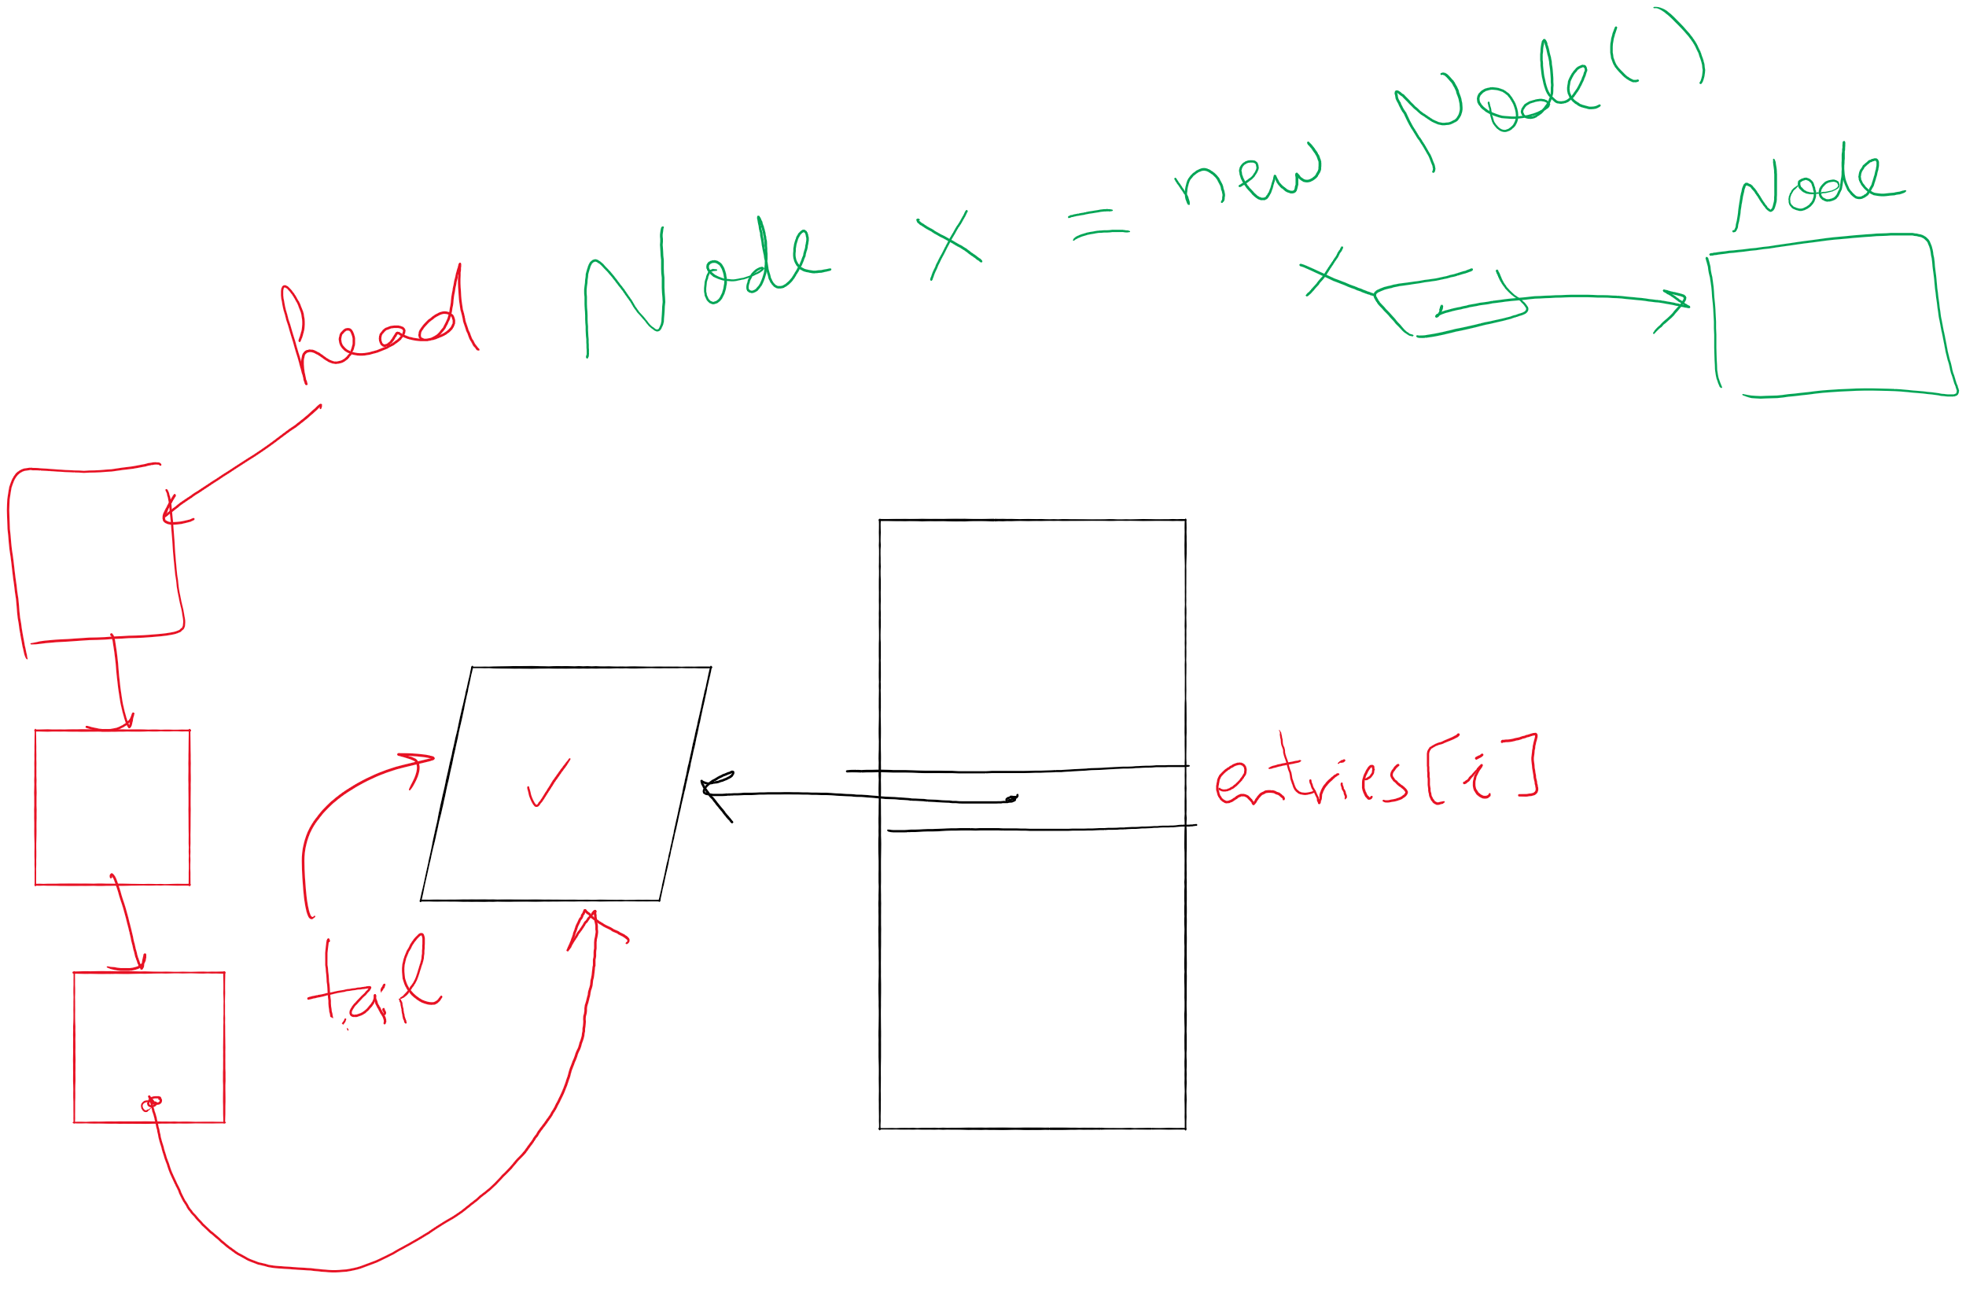
Lab 6

Slide 27
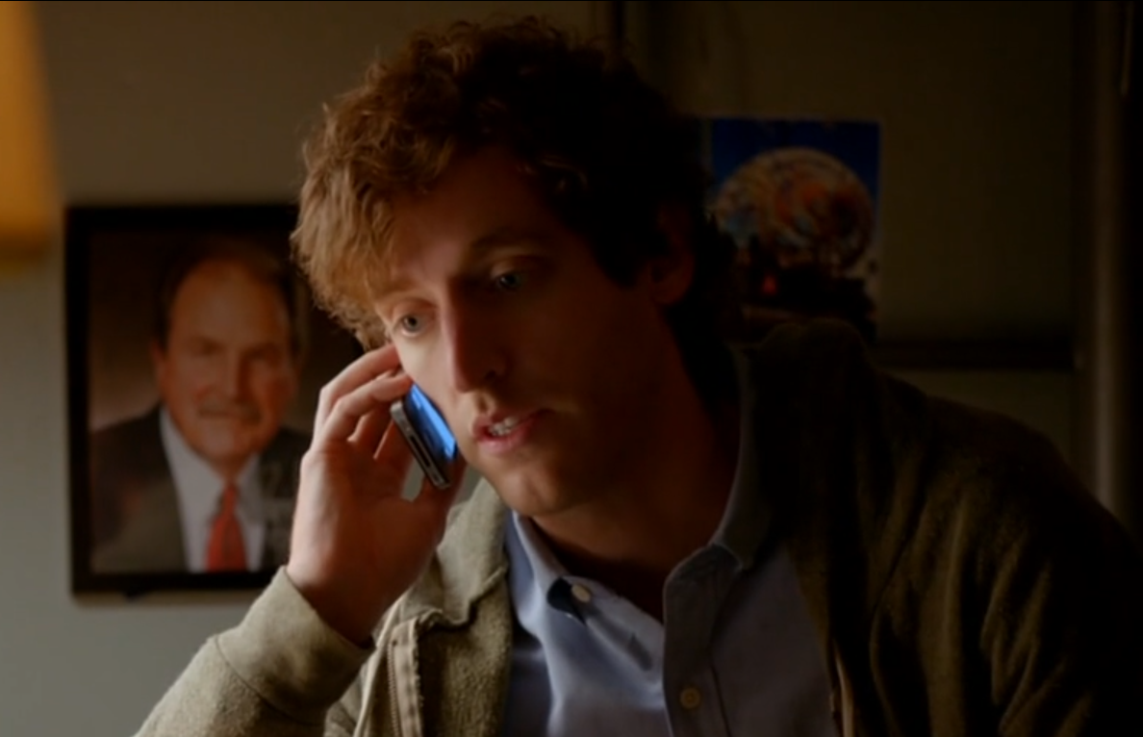
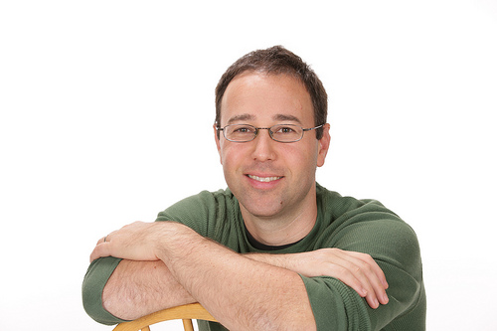
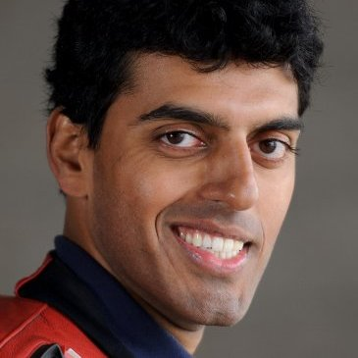
A final note on compression evaluation
"Weissman scores" are a made-up metric for Silicon Valley (TV)
Notes:
first: Prof. Tsachy (Itschak) Weissman (Stanford Dept. of EE)
second: Vinith Misra, advised by Weissman while getting his PhD from Stanford, now at IBM
Misra was a technical advisor to silicon valley team, made the shows technical contributions seem like something experts could watch a powerpoint on and buy

Slide 28
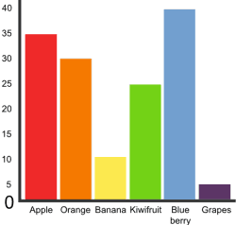
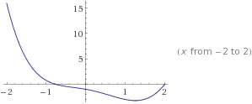
Graphs!
5
3
4
0
2
1

Slide 29
Graphs
A graph G = (V, E)
Where V is a set of vertices
E is a set of edges connecting vertex pairs
Example:
V = {0, 1, 2, 3, 4, 5}
E = {(0, 1), (0, 4), (1, 2), (1, 4), (2, 3), (3, 4), (3, 5)}
5
3
4
0
2
1

Slide 30
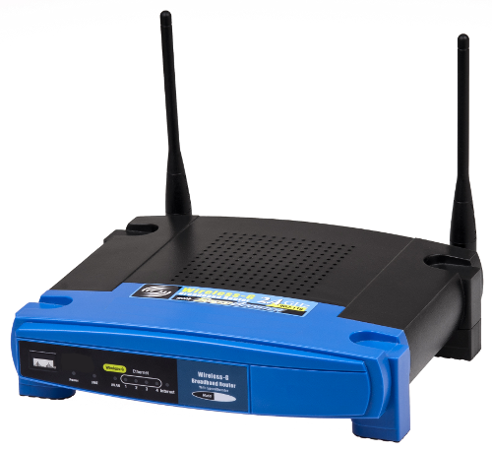
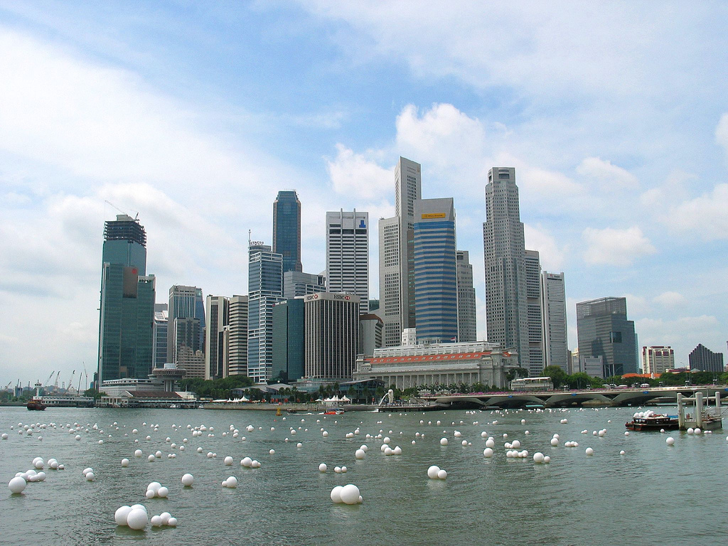
Why?
Can be used to model many different scenarios

Slide 31
Some definitions
Undirected graph
Edges are unordered pairs: (A, B) == (B, A)
Directed graph
Edges are ordered pairs: (A, B) != (B, A)
Adjacent vertices, or neighbors
Vertices connected by an edge

Slide 32
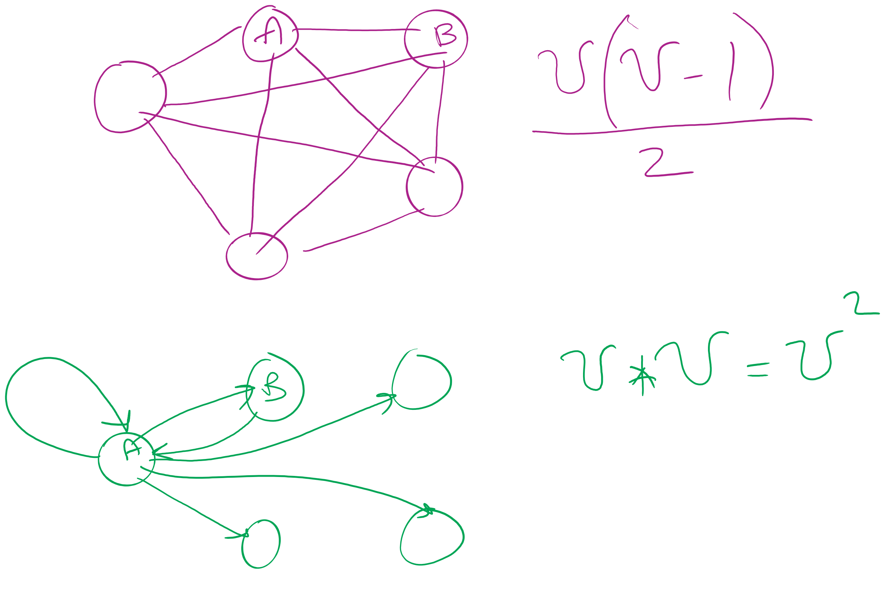
Graph sizes
Let v = |V|, and e = |E|
Given v, what are the minimum/maximum sizes of e?
Minimum value of e?
Definition doesn’t necessitate that there are any edges…
So, 0
Maximum of e?
Depends…
Are self edges allowed?
Directed graph or undirected graph?
In this class, we'll assume directed graphs have self edges while undirected graphs do not
Notes:
directed (w/ self edges)
v vertices each with edges to v vertices
v²
undirected (no self edges)
v vertices with edges to v-1 vertices
BUT remember for undirected, (1, 2) == (2, 1)
v(v - 1) / 2
(v² - v) / 2

Slide 33
More definitions
A graph is considered sparse if:
e <= v lg v
A graph is considered dense as it approaches the maximum number of edges
I.e., e == MAX - ε
A complete graph has the maximum number of edges
Notes:
v² - ε for directed
((v² - v) / 2) - ε for undirected
Have we seen “sparse” and dense before?
yes -- with tries, for sparse tries DLB is better; for dense, R-way tries are better

Slide 34
Question:
5
5
==
or
!=
3
4
4
3
0
0
2
1
1
2
?
Notes:
Different spatial representations of the same vertices/edges are considered the same graph

Slide 35
Representing graphs
Trivially, graphs can be represented as:
List of vertices
List of edges
Performance?
Assume we're going to be analyzing static graphs
I.e., no insert and remove
So what operations should we consider?
Notes:
We haven’t talked about problems to solve yet, but can you imagine tasks you might want to do with graphs?

Slide 36
Using an adjacency matrix
Rows/columns are vertex labels
M[i][j] = 1 if (i, j) ∈ E
M[i][j] = 0 if (i, j) ∉ E
 | 0 | 1 | 2 | 3 | 4 | 5
0 | 0 | 1 | 0 | 0 | 1 | 0
1 | 1 | 0 | 1 | 0 | 1 | 0
2 | 0 | 1 | 0 | 1 | 0 | 0
3 | 0 | 0 | 1 | 0 | 1 | 1
4 | 1 | 1 | 0 | 1 | 0 | 0
5 | 0 | 0 | 0 | 1 | 0 | 0

Slide 37
Using an adjacency matrix
Rows/columns are vertex labels
M[i][j] = 1 if (i, j) ∈ E
M[i][j] = 0 if (i, j) ∉ E
 | 0 | 1 | 2 | 3 | 4 | 5
0 | 0 | 1 | 0 | 0 | 1 | 0
1 | 1 | 0 | 1 | 0 | 1 | 0
2 | 0 | 1 | 0 | 1 | 0 | 0
3 | 0 | 0 | 1 | 0 | 1 | 1
4 | 1 | 1 | 0 | 1 | 0 | 0
5 | 0 | 0 | 0 | 1 | 0 | 0

Slide 38
Adjacency matrix analysis
Runtime?
Space?
Notes:
Time:
Check edge existence in Θ(1)
Θ(v) to find the neighbors of a vertex
Θ(v²) time to initialize
Space:
Θ(v²) memory
Regardless of |E|

Slide 39
Adjacency lists
Array of neighbor lists
A[i] contains a list of the neighbors of vertex i
0
1
2
3
4
5
1
0
1
2
0
3
4
2
3
4
1
4
5
3

Slide 40
Adjacency list analysis
Runtime?
Space?
Notes:
Time:
Θ(d) to check edge existence/find the neighbors of a vertex
Where d is the degree of a vertex
# of neighbors
Can be up to Θ(v) to check edge existence/find the neighbors of a vertex
Space:
Θ(v + e) memory
Plus overhead of node use
Could be much less than v²

Slide 41
Comparison
Where would we want to use adjacency lists vs adjacency matrices?
What about the list of vertices/list of edges approach?
Notes:
Adjacency matrix is better for dense graphs
Adjacency list is better for sparse graphs
Lists approach is bad
Aside from not storing redundant edge info for undirected graphs, worse than adj list

Slide 42
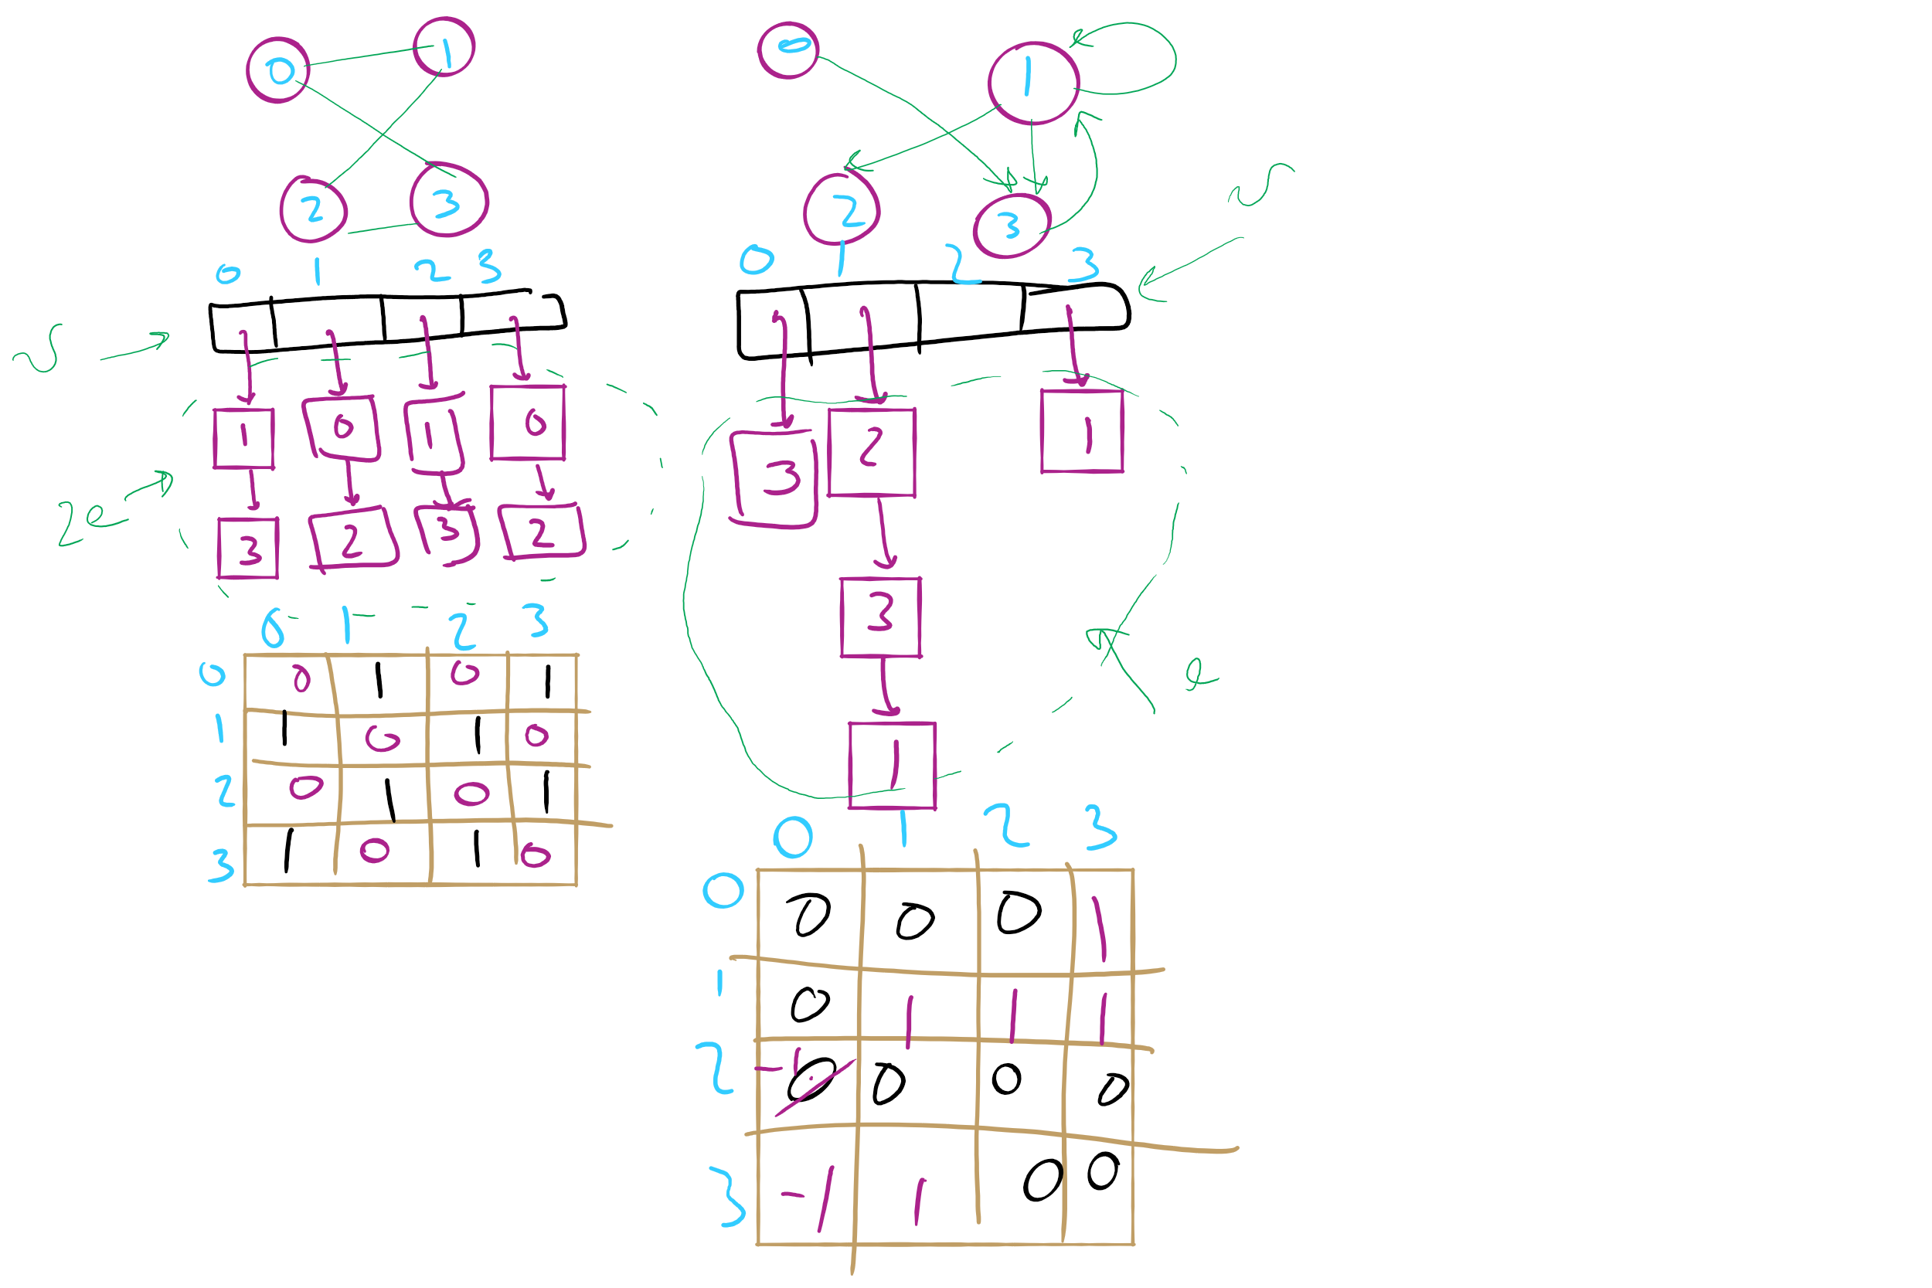
Graph Representation Example 1

Slide 43
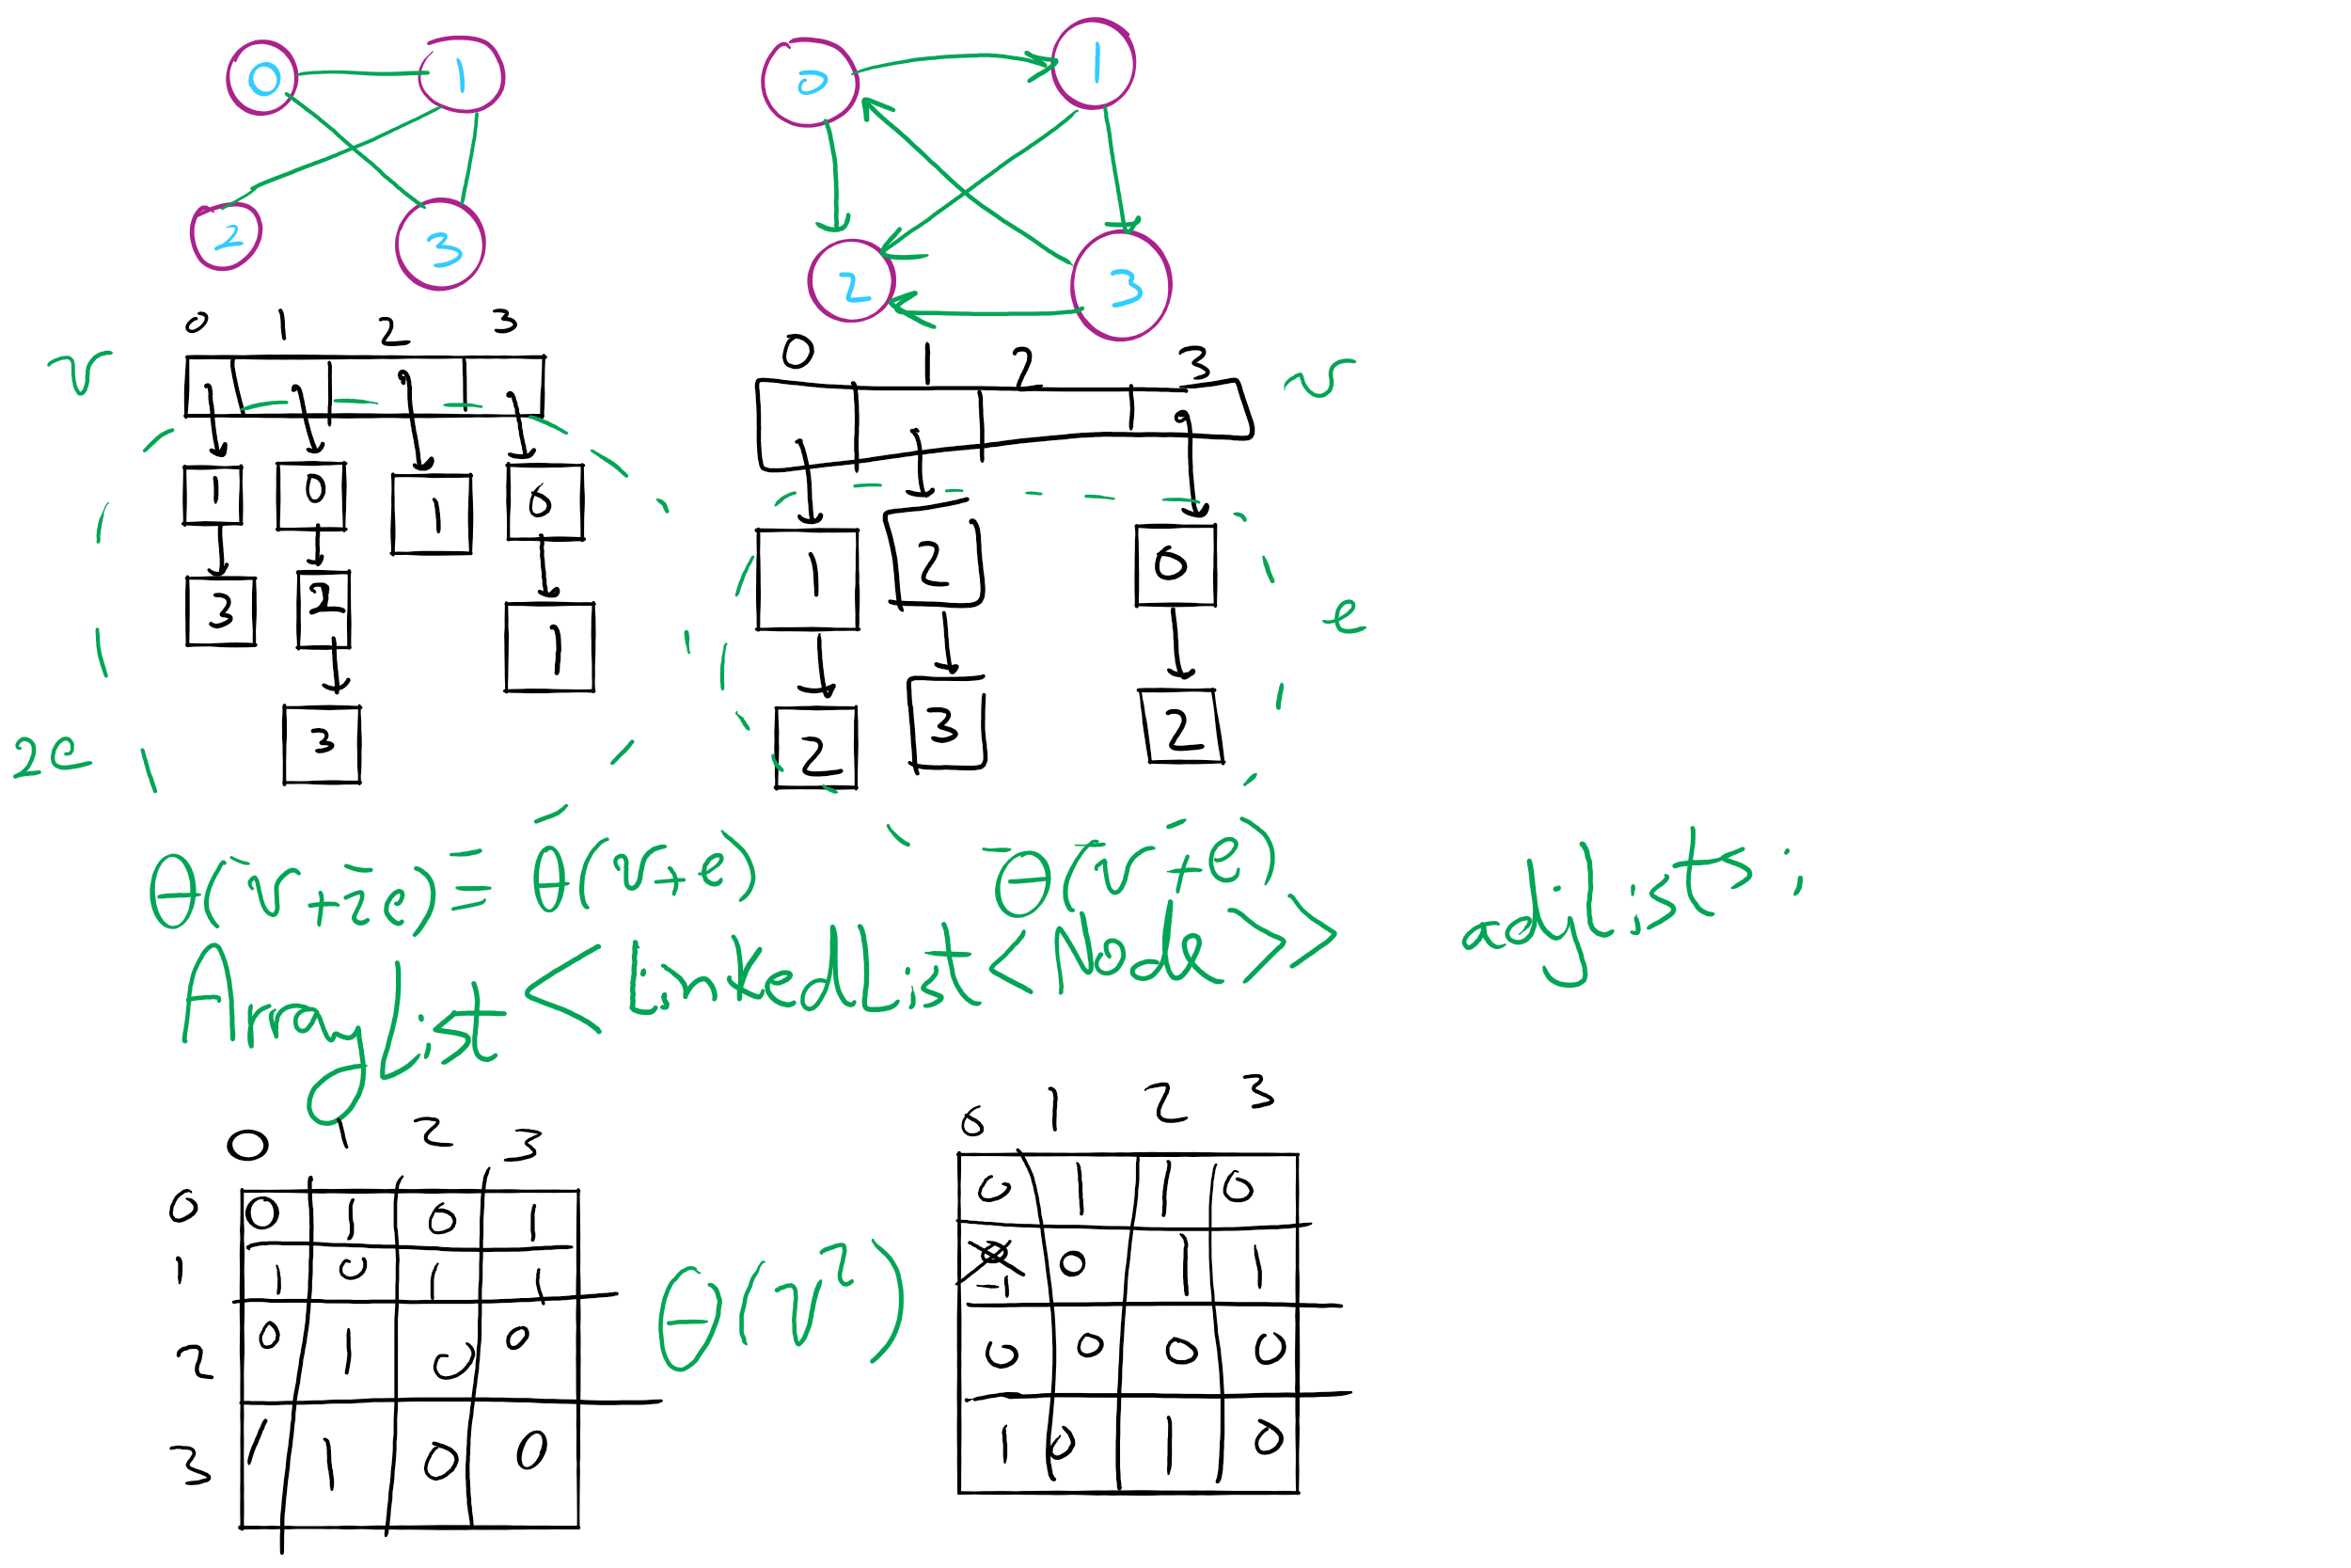
Graph Representation Example 2

Slide 44
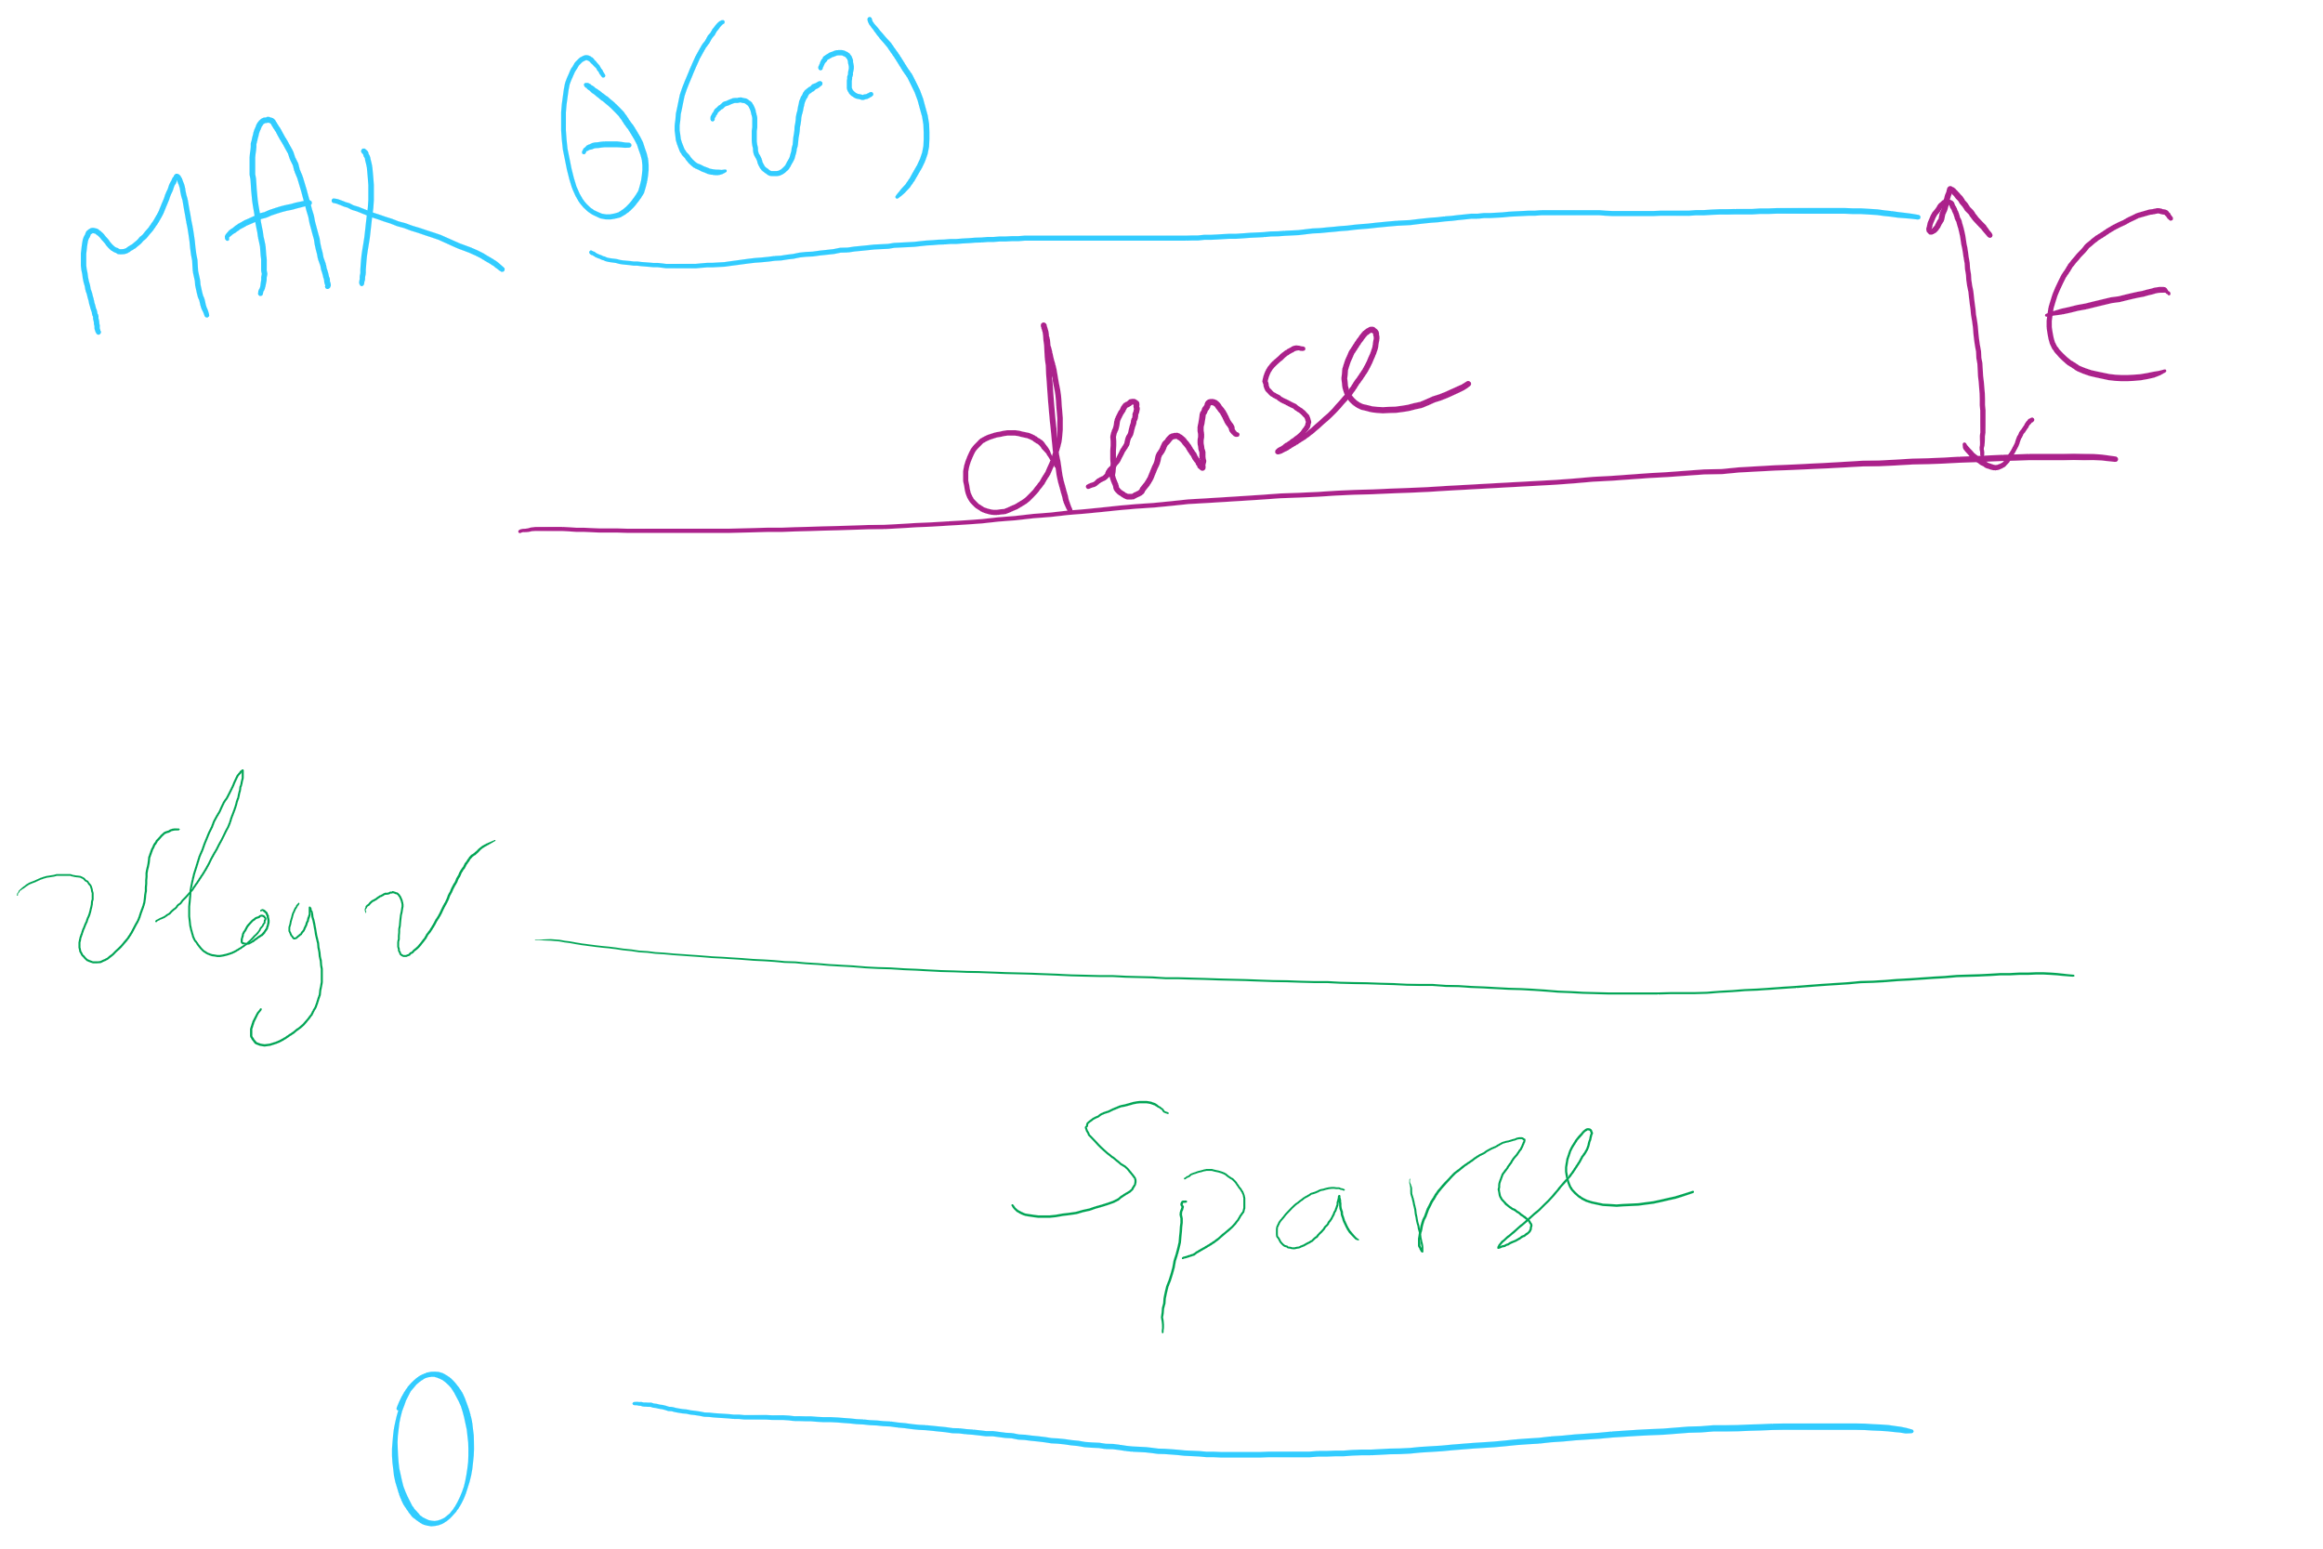
Graph Density

Slide 45
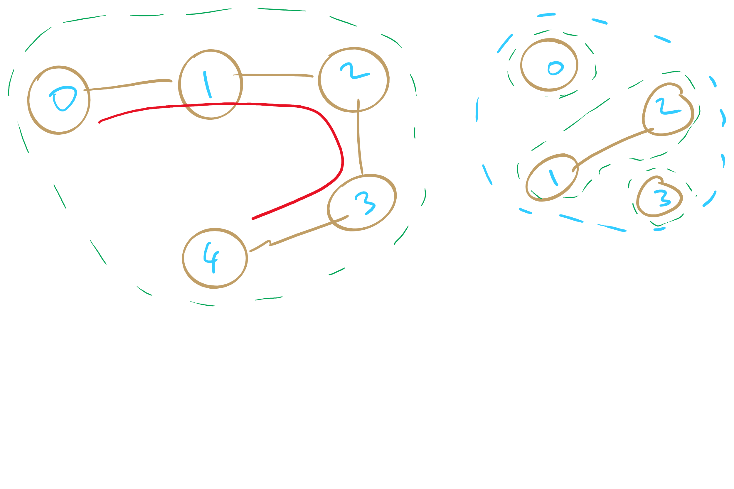
Sparse Graphs

Slide 46
Next …
Graph Traversal
BFS
DFS
Articulation points
Minimum Spanning Tree
Prim’s algorithm

Slide 47
Comparison
Where would we want to use adjacency lists vs adjacency matrices?
What about the list of vertices/list of edges approach?
Notes:
Adjacency matrix is better for dense graphs
Adjacency list is better for sparse graphs
Lists approach is bad
Aside from not storing redundant edge info for undirected graphs, worse than adj list

Slide 48
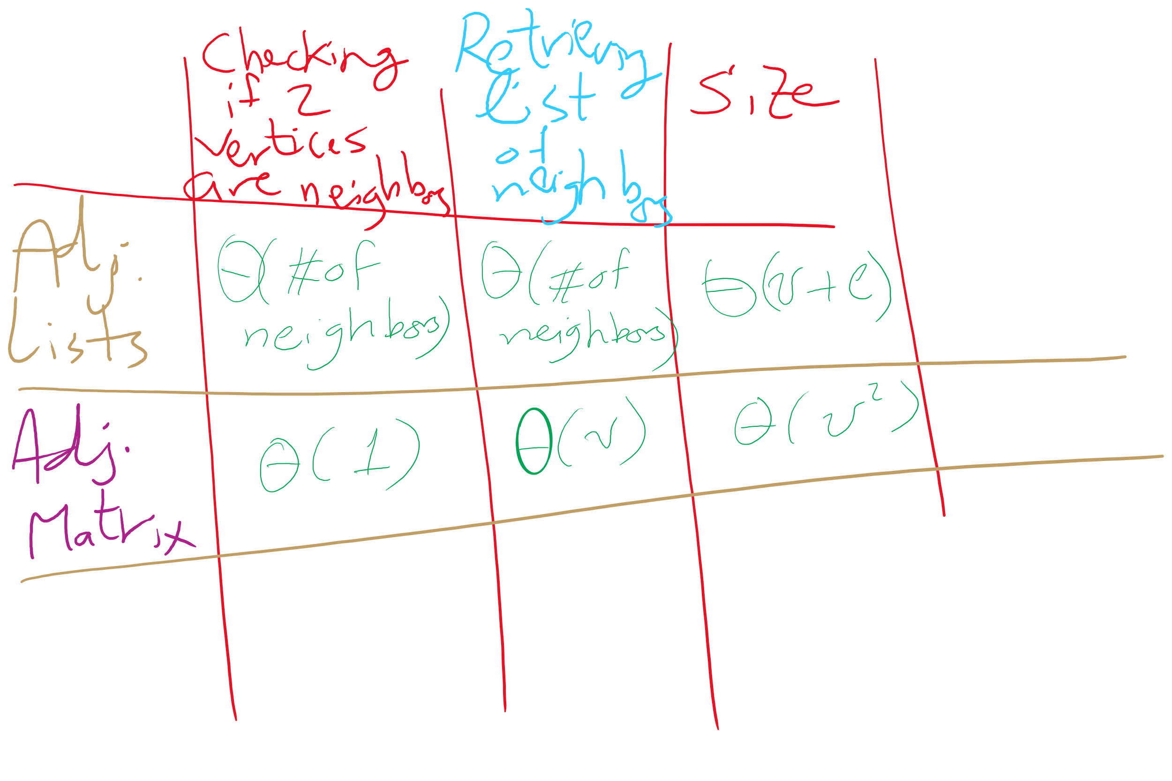
Adjacency Matrix vs. Adjacency Lists

Slide 49
Even more definitions
Path
A sequence of adjacent vertices
Simple Path
A path in which no vertices are repeated
Simple Cycle
A simple path with the same first and last vertex
Connected Graph
A graph in which a path exists between all vertex pairs
Connected Component
Connected subgraph of a graph
Acyclic Graph
A graph with no cycles
Tree
?
A connected, acyclic graph
Has exactly v-1 edges
Notes:
Difference between Connected graph and Complete graph?
Connected means there is a path from vertA to vertB
Complete means maximum number of edges in graph (so, vertA has edge to vertB)

Slide 50
Graph traversal
What is the best order to traverse a graph?
Two primary approaches:
Depth-first search (DFS)
“Dive” as deep as possible into the graph first
Branch when necessary
Breadth-first search (BFS)
Search all directions evenly
I.e., from i, visit all of i’s neighbors, then all of their neighbors, etc.

Slide 51
DFS
Already seen and used this throughout the term
For tries…
For Huffman encoding…
Can be easily implemented recursively
For each vertex, visit first unseen neighbor
Backtrack at deadends (i.e., vertices with no unseen neighbors)
Try next unseen neighbor after backtracking

Slide 52
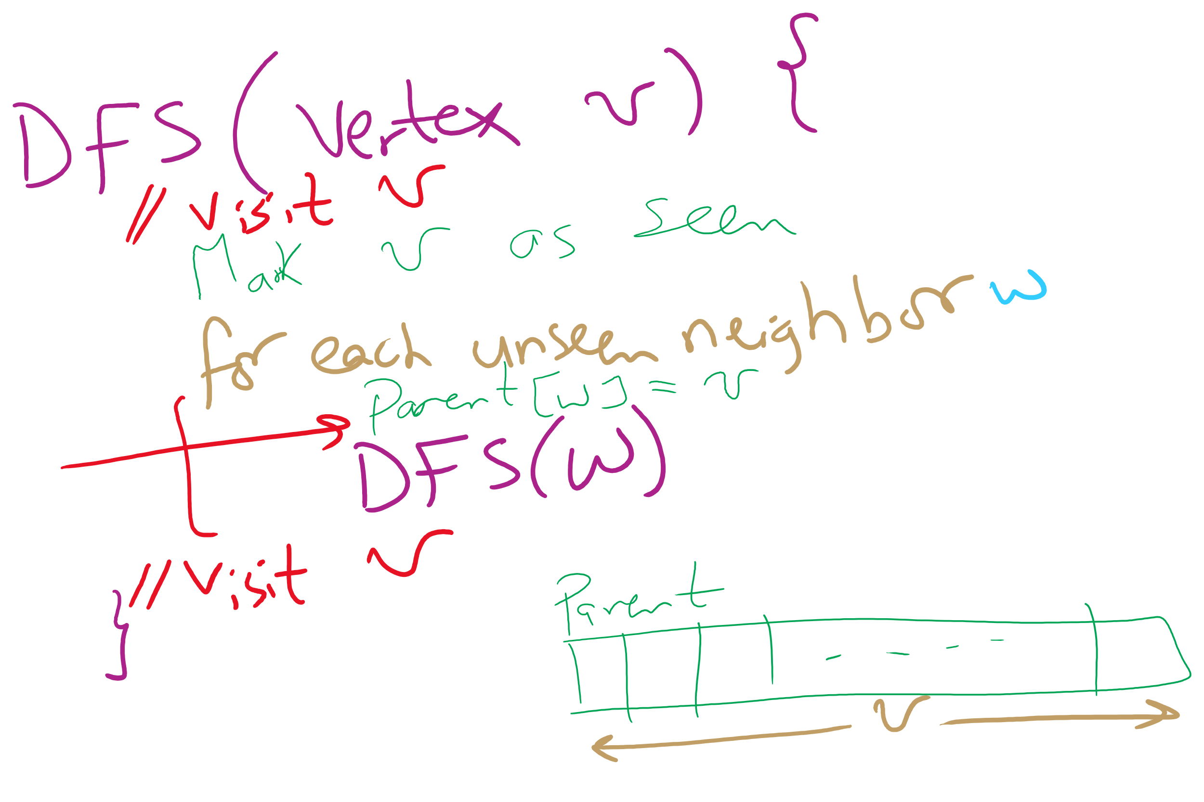
DFS Pseudo-code

Slide 53
DFS example
5
5
3
4
3
4
0
0
2
2
1
1

Slide 54
DFS example 2
0
0
2
1
2
1
3
3
6
6
4
5
4
5
7
7
9
9
8
8

Slide 55
BFS
Can be easily implemented using a queue
For each vertex visited, add all of its neighbors to the queue
Vertices that have been seen but not yet visited are said to be the fringe
Pop head of the queue to be the next visited vertex
See example

Slide 56
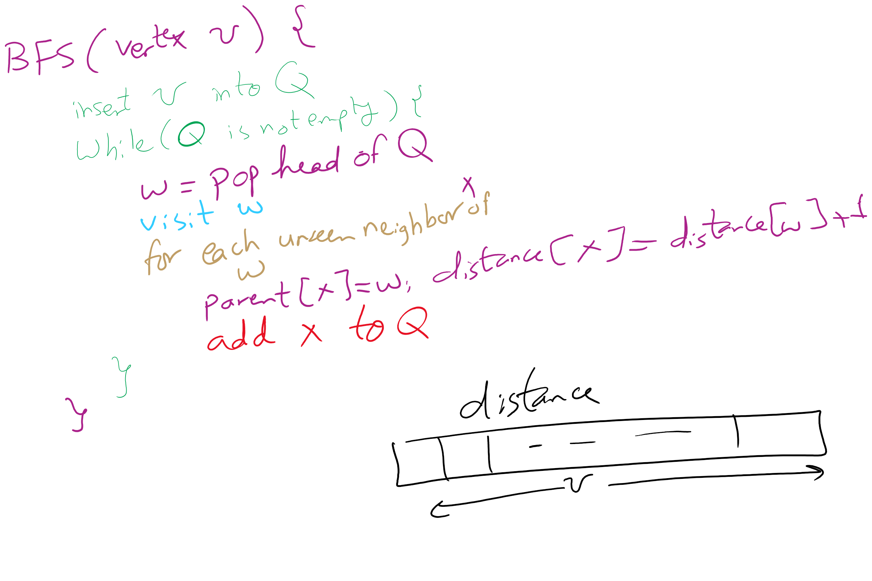
BFS Pseudo-code

Slide 57
BFS example
Q
0
0
1
7
2
1
2
1
2
9
3
3
6
6
3
8
4
5
4
5
4
7
7
5
9
9
6
8
8
Notes:
note that we are building connected, acyclic graphs with both bfs and dfs (will define on next slide)
get students to pick out that we are also doing shortest paths with bfs

Slide 58
Shortest paths
BFS traversals can further be used to determine the shortest path between two vertices

Slide 59
Analysis of graph traversals
At a high level, DFS and BFS have the same runtime
Each vertex must be seen and then visited, but the order will differ between these two approaches
How will the representation of the graph affect the runtimes of of these traversal algorithms?
Notes:
Adjacency matrix
Θ(v) to consider all neighbors
To traverse a row/column of the matrix
Doing this for each of v vertices leads to Θ(v²) runtime
Adjacency list
Must consider the neighbor list of each vertex in the array
So, we must visit every vertex in the whole adjacency list
Θ(v + e)

Slide 60
Please submit your reflections by using the CourseMIRROR App
If you are having a problem with CourseMIRROR, please send an email to coursemirror.development@gmail.com
Notes:
All right!
Upcoming Due Dates at A Glance

